Slide 1

Hand Hygiene Practices
An In-Service Training Program
Instructor Presentation & Notes
Provided Courtesy of
Notes:
Source:
F880 – Infection Prevention and Control Program regulations and interpretive guidelines.
CDC Guideline for Hand Hygiene in Healthcare Settings.
World Health Organization (WHO) Guidelines on Hand Hygiene in Health Care.
Handouts: The following handouts are located in Part 2. Use at your discretion.
Handout #1 – Participant Session Outline.
Handout #2 – Key Moments for Hand Hygiene.
Handout #3 – Handwashing Techniques.
Handout #4 – Alcohol-Based Handrub (ABHR) Techniques.
Handout #5 – Handwashing Competency Validation Checklist.
Handout #6 – Competency Evaluation Exam.
Modify this training session to meet your facility’s needs. Information is presented as a template only. Remind participants to sign the Record of Attendance Form.
OPTIONAL: Provide participants with Handout #1 – Participant Session Outline.

Slide 2
Session Objectives
Upon completion of this training session, you should be able to:
Define hand hygiene practices.
Discuss the importance of hand hygiene.
Discuss reasons staff give for not performing hand hygiene practices.
Provide examples of when hands should be washed with soap and water.
Discuss why “jewelry” should not be worn when providing care to residents.
Discuss the relationship between gloving and hand hygiene.
Discuss when gloves should be used.
Identify and provide examples of the 5 moments when hand hygiene must be performed.
Discuss and review the facility’s Hand Hygiene Policies and Procedures.
Notes:
Suggestion: Prior to moving to the next slide, ask participants what hand hygiene practices mean to them. This will provide you with a sense of how knowledgeable your participants are about your facility’s hand hygiene practices.
Tell participants that each of these objectives are discussed during the training session.

Slide 3
Definitions
“Hand Hygiene” is a general term that applies to hand washing with soap and water, or the use of a waterless alcohol-based antiseptic handrub (ABHR).
“Hand Washing” is defined as the vigorous, brief rubbing together of all surfaces of hands with soap and water, followed by rinsing under a stream of water.
“Alcohol-Based Handrub (ABHR)” is defined as rubbing the hands with an alcohol-containing preparation (liquid, gel, or foam) containing at least 60% alcohol.
Notes:
Source: SOM Appendix PP, F880, Definitions.

Slide 4
Reasons Staff Gives for NOT Performing
Hand Hygiene Practices
Handwashing agents cause irritation and dryness.
Sinks are inconveniently located.
Lack of sinks.
Lack of soap, hand sanitizers, paper towels.
Too busy / not enough time.
Resident’s needs takes priority.
Notes:
Suggestion: Before reviewing the reasons discussed here, ask participants to discuss reasons why they may not always perform hand hygiene practices when providing resident care.
Compare slide content with reasons participants gave.
Discuss as you deem necessary or appropriate to address the importance of performing hand hygiene practices.
If the availability of equipment and/or supplies is an issue, you should provide that information to Environmental Services, or other that has the authority to investigate and resolve such issues.
Other reasons you may want to discuss:
Culture.
Not washing long enough.
Forget to wash.

Slide 5
The Importance of Hand Hygiene
The most common way that germs are spread and cause infection is by being carried on people’s hands.
According to the Centers for Disease Control (CDC), hand hygiene is the most important measure to prevent the spread of harmful germs and to prevent health care associated infections.
Regular and thorough hand hygiene is always important when working in the health care environment.
Having clean hands helps to protect our residents, as well as yourself and others.
Notes:
Ask participants why they think hand hygiene practices are important when providing resident care.
Discuss as you deem necessary or appropriate to ensure participants have a working knowledge of the importance of hand hygiene not only to protect the resident, but for their own well-being and safety.

Slide 6
Hand Hygiene Practices
You should wash your hands with soap and water after using the restroom, before and after preparing or serving a meal, if visibly dirty, when exposed to C. difficle, or when exposed to blood or other body fluids.
Do not use hot water to wash or rinse your hands as it can cause skin to dry and crack.
If hands are NOT visibly soiled, use an alcohol-based handrub (liquid, gel, or foam), containing at least 60% alcohol, to routinely clean your hands.
The use of gloves does NOT eliminate the need for hand hygiene.
Fingernails and jewelry play a key but an over-looked role in hand hygiene.
You should always wash your hands prior to beginning and upon leaving work.
Notes:
Inform participants that the next few slides contain helpful information about how and when to perform hand hygiene practices.
As you review each point, ask participants if they have any concerns or issues about the material discussed.
Note: Research has shown that it is not the temperature of the water that kills the bacteria, but the thorough washing of the hands with soap. Be sure to lather all surfaces (back of hands, between and around all fingers, tips of fingers, wrists, and palms) for at least 15-20 seconds. (See 2nd Bullet Point).

Slide 7
Hand Hygiene Practices (continued)
While artificial nails may not spread infection, caregivers with artificial nails are more likely to harbor pathogens on their fingertips even after performing hand hygiene.
Keep natural nails less than one-quarter (1/4) inch long.
Chipped nail polish may support the growth of germs and bacteria.
Skin underneath rings and bracelets has more germs than the surrounding skin.
Remove jewelry before cleaning hands. If you want to keep your wedding band on, be sure you clean underneath it.
Notes:
Ask participants if they believe wearing jewelry or having artificial fingernails cause any concerns for them during hand hygiene practices. Ask them to explain their response.
Discuss responses as you deem necessary or appropriate to ensure participants have a working knowledge of the importance of ensuring that hands are clean.
You may want to review your facility’s policies concerning the wearing of jewelry or artificial nails to ensure participants are aware of such policies.

Slide 8
Hand Hygiene Practices (continued)
Towelettes and hand wipes should NOT be used in place of alcohol-based handrubs or soap and water.
Frequent hand washing can cause skin irritation and dermatitis.
Use a hand cream or lotion daily to help the skin better withstand frequent hand hygiene cleaning.
Be sure your hands are completely dry before putting on gloves.
After removing gloves, wash your hands.
Notes:
Ask participants about any hand care issues (e.g., cuts, wounds, cracked skin, etc.) they may be experiencing and how they may be addressing those issues.
Ask participants if they report skin conditions they may be experiencing to their supervisor.
Discuss as you deem necessary or appropriate to ensure that participants are following the facility’s skin condition reporting protocols.

Slide 9
Use of Gloves
Gloving is necessary:
  When hands may become contaminated with blood, body fluids, excretions, or secretions, or when touching open wounds or mucous membranes, such as the mouth and respiratory tract.
  When touching items that are likely to be contaminated, such as urinary catheters and endotracheal tubes, and contaminated surfaces or objects.
  When resident care and the environment restrictions require it (e.g., isolation and contact precautions).
Notes:
Ask participants to provide instances when they use gloves. Do they align with the points addressed here and/or with your facility’s policies?
Discuss as you deem necessary or appropriate to ensure participants have a working knowledge of when and how to use gloves during the hand hygiene process.
Instructor Note: The use of PPE is addressed in our facility’s Personal Protective Equipment (PPE) Training Program.

Slide 10
The Relationship Between Gloving and Hand Hygiene
Hand hygiene should be performed when indicated, regardless of glove use.
This means that if there is an indication for hand hygiene and an indication of glove use, hand hygiene should be performed first, and then gloves should be put on.
Hand hygiene should also be performed after gloves are removed.
Remember, gloves are NOT a substitute for hand hygiene.
Notes:
Discuss these points to ensure participants have a working knowledge of the importance of hand hygiene even when gloves are used.

Slide 11
Correct Glove Use
Putting on and removing gloves appropriately helps to protect both the resident and the caregiver. You should:
  Put on new gloves before contact with non-intact skin or mucous membranes.
  Wear gloves during contact with body fluids or contaminated items.
  Remove gloves after caring for a resident. (Do not wear the same gloves for more than one resident.)
  Change gloves when moving from a contaminated body site to a clean body site on a resident. Do not reuse or wash gloves.
  According to the CDC, even with glove use, hand hygiene is necessary AFTER glove removal because hands can become contaminated through small defects in gloves and from the outer surface of gloves during glove removal.
Notes:
Suggestion: Ask two participants to volunteer to demonstrate, and/or describe how they put on and remove gloves.
From the demonstration, or discussion, review results with slide content to ensure participants have a working knowledge of correct glove use.
You may want to review your facility’s policies governing the use of gloves to be sure they align with information presented on this slide, as well as with how participants demonstrated or described their use of gloves.
Instructor Note: See also facility’s Personal Protective Equipment (PPE) Inservice Training Program.

Slide 12
5 Key Moments of Hand Hygiene
The World Health Organization (WHO) has identified five (5) key moments when hand hygiene must be performed. They are:
Before touching the resident.
Before performing a clean / aseptic procedure.
After exposure to blood or other body fluids.
After touching a resident.
After touching the resident’s surroundings.
Notes:
Suggestion: Before reviewing this slide, ask participants if they can identify any of the five key moments of hand hygiene practices.
The intent here is to determine IF participants recognize events (opportunities / key moments) when hand hygiene MUST be performed.
Optional Handout Use: To aid in teaching the 5 Key Moments, the World Health Organization’s (WHO) poster is provided in Handout #2.
Inform participants that each of these 5 key moments will be discussed during the remaining portion of this session.

Slide 13
#1 – Before Touching the Resident
Why: To protect the resident against harmful germs carried on the hands of the caregiver.
When | Examples of #1 – Before Touching a Resident* (*not an all-inclusive listing)
Clean your hands before touching a resident when approaching him/her. Hand hygiene must be performed in all indications regardless of whether gloves are used or not. | Prior to touching the resident’s environment (e.g., door handle, bed, bedside table, furniture, possessions, etc.). Prior to shaking hands with the resident. Prior to assisting a resident in personal care activities (e.g., to move, to take a bath, to eat, to dress, etc.). Prior to taking any vital signs (e.g., temperature, pulse, blood pressure, etc.). Prior to touching a medical device connected to the resident. Prior to administering oral medications. Prior to putting on gloves.
Notes:
Review the WHY, WHEN, and Examples. Keep in mind the listed examples are NOT all inclusive – they are provided only as examples and may not reflect your facilities practices. Modify as necessary to meet your facility’s needs.
Discuss as you deem necessary or appropriate to ensure participants have a working knowledge of hand hygiene practices that must be followed BEFORE Touching the Resident.

Slide 14
#2 – Before Performing a Clean/Aseptic Procedure
Why: To protect the resident against infection with harmful germs, including the resident’s own, from entering the resident’s body.
When | Examples of #2 – Before Performing a Procedure* (*not an all-inclusive listing)
Clean your hands immediately before performing any procedure. Once hand hygiene has been performed, nothing else in the resident’s room / care area should be touched prior to starting the procedure. Hand hygiene must be performed in all indications regardless of whether gloves are used or not. | Before brushing the resident’s teeth, instilling eye drops, performing a digital vaginal or rectal examination, examining the mouth, nose, or ear with or without an instrument, inserting a suppository / pessary, suctioning mucous, etc. Before dressing a wound with or without an instrument, applying ointments, making a percutaneous injection / puncture. Before inserting an invasive medical device (e.g., nasal cannula, nasogastric tube, endotrachael tube, urinary probe, percutaneous catheter drainage, etc.), disrupting / opening any circuit of an invasive medical device (for food, IV medication, vaccination, drainage, suctioning, monitoring purposes, etc.). Before preparing food, medications, sterile material, etc.
Notes:
Review the WHY, WHEN, and Examples. Keep in mind the listed examples are NOT all inclusive – they are provided only as examples and may not reflect your facilities practices. Modify as necessary to meet your facility’s needs.
Discuss as you deem necessary or appropriate to ensure participants have a working knowledge of hand hygiene practices that must be followed BEFORE Performing a Clean/Aseptic Procedure.

Slide 15
#3 – After Body Fluid Exposure Risk
Why: To protect the caregiver from infection with the resident’s harmful germs and to protect the surrounding environment from the spread of harmful germs.
When | Examples of #3 – After Body Fluid Risk Exposure* (*not an all-inclusive list)
Clean your hands as soon as the task involving an exposure risk to body fluids has ended and after glove removal. Hand hygiene must be performed in all indications regardless of whether gloves are used or not. | After a dressing change. After skin lesion care. After inserting an IV. After taking a specimen (e.g., urine, blood, stool). After cleaning up a body fluid spill. After inserting a catheter, feeding tube, etc. After providing oral care. After removal of a catheter, feeding tube, etc. After removal of any form or material offering protection (e.g., dressing, gauze, towel, etc.). After cleaning any contaminated surface.
Notes:
Review the WHY, WHEN, and Examples. Keep in mind the listed examples are NOT all inclusive – they are provided only as examples and may not reflect your facilities practices. Modify as necessary to meet your facility’s needs.
Discuss as you deem necessary or appropriate to ensure participants have a working knowledge of hand hygiene practices that must be followed AFTER Body Fluid Exposure Risk.

Slide 16
#4 – After Touching A Resident
Why: To protect the caregiver from infection with the resident’s harmful germs and to protect the surrounding environment from the spread of harmful germs.
When | Examples of #4 – After Touching the Resident* (*not an all-inclusive list)
Clean your hands after leaving the resident’s side, after having touched the resident. Hand hygiene must be performed in all indications regardless of whether gloves are used or not. | After you have assisted the resident in personal care activities (e.g., to move, to bath, to eat, to dress, etc.). After delivering care and other non-invasive treatment. After changing bed linen while the resident is in the bed. Applying oxygen mask, splints, braces, etc. After giving a massage. After taking a pulse, temperature, measuring blood pressure, etc. After shaking hands, After touching the resident upon exiting the room.
Notes:
Review the WHY, WHEN, and Examples. Keep in mind the listed examples are NOT all inclusive – they are provided only as examples and may not reflect your facilities practices. Modify as necessary to meet your facility’s needs.
Discuss as you deem necessary or appropriate to ensure participants have a working knowledge of hand hygiene practices that must be followed AFTER Touching a Resident.

Slide 17
#5 – After Touching the Resident’s Surroundings
Why: To protect the caregiver from germs that may be present on surfaces and objects in the resident’s surroundings and to protect the facility from the spread of germs.
When | Examples of #5 – After Touching Resident’s Surroundings* (*not an all-inclusive listing)
Clean your hands after touching any object or furniture when leaving the resident’s surroundings, without having touched the resident. Hand hygiene must be performed in all indications regardless of whether gloves are used or not. | After touching the resident’s surroundings (e.g., bed, bedside table, chairs, TV remote, etc.). After an activity involving physical contact with the resident’s immediate environment (e.g., changing bed linen while resident is out of the bed, holding a bed pan, clearing a bedside table, etc.). After a care activity (e.g., adjusting bed, resetting a bed alarm, etc.). After touching the resident’s wheelchair, walker, cane, etc. After other contacts with surfaces or objects (e.g., leaning against a bed, leaning against a nightstand, touching door handles, etc.).
Notes:
Review the WHY, WHEN, and Examples. Keep in mind the listed examples are NOT all inclusive – they are provided only as examples and may not reflect your facilities practices. Modify as necessary to meet your facility’s needs.
Discuss as you deem necessary or appropriate to ensure participants have a working knowledge of hand hygiene practices that must be followed AFTER Touching the Resident’s Surroundings.

Slide 18
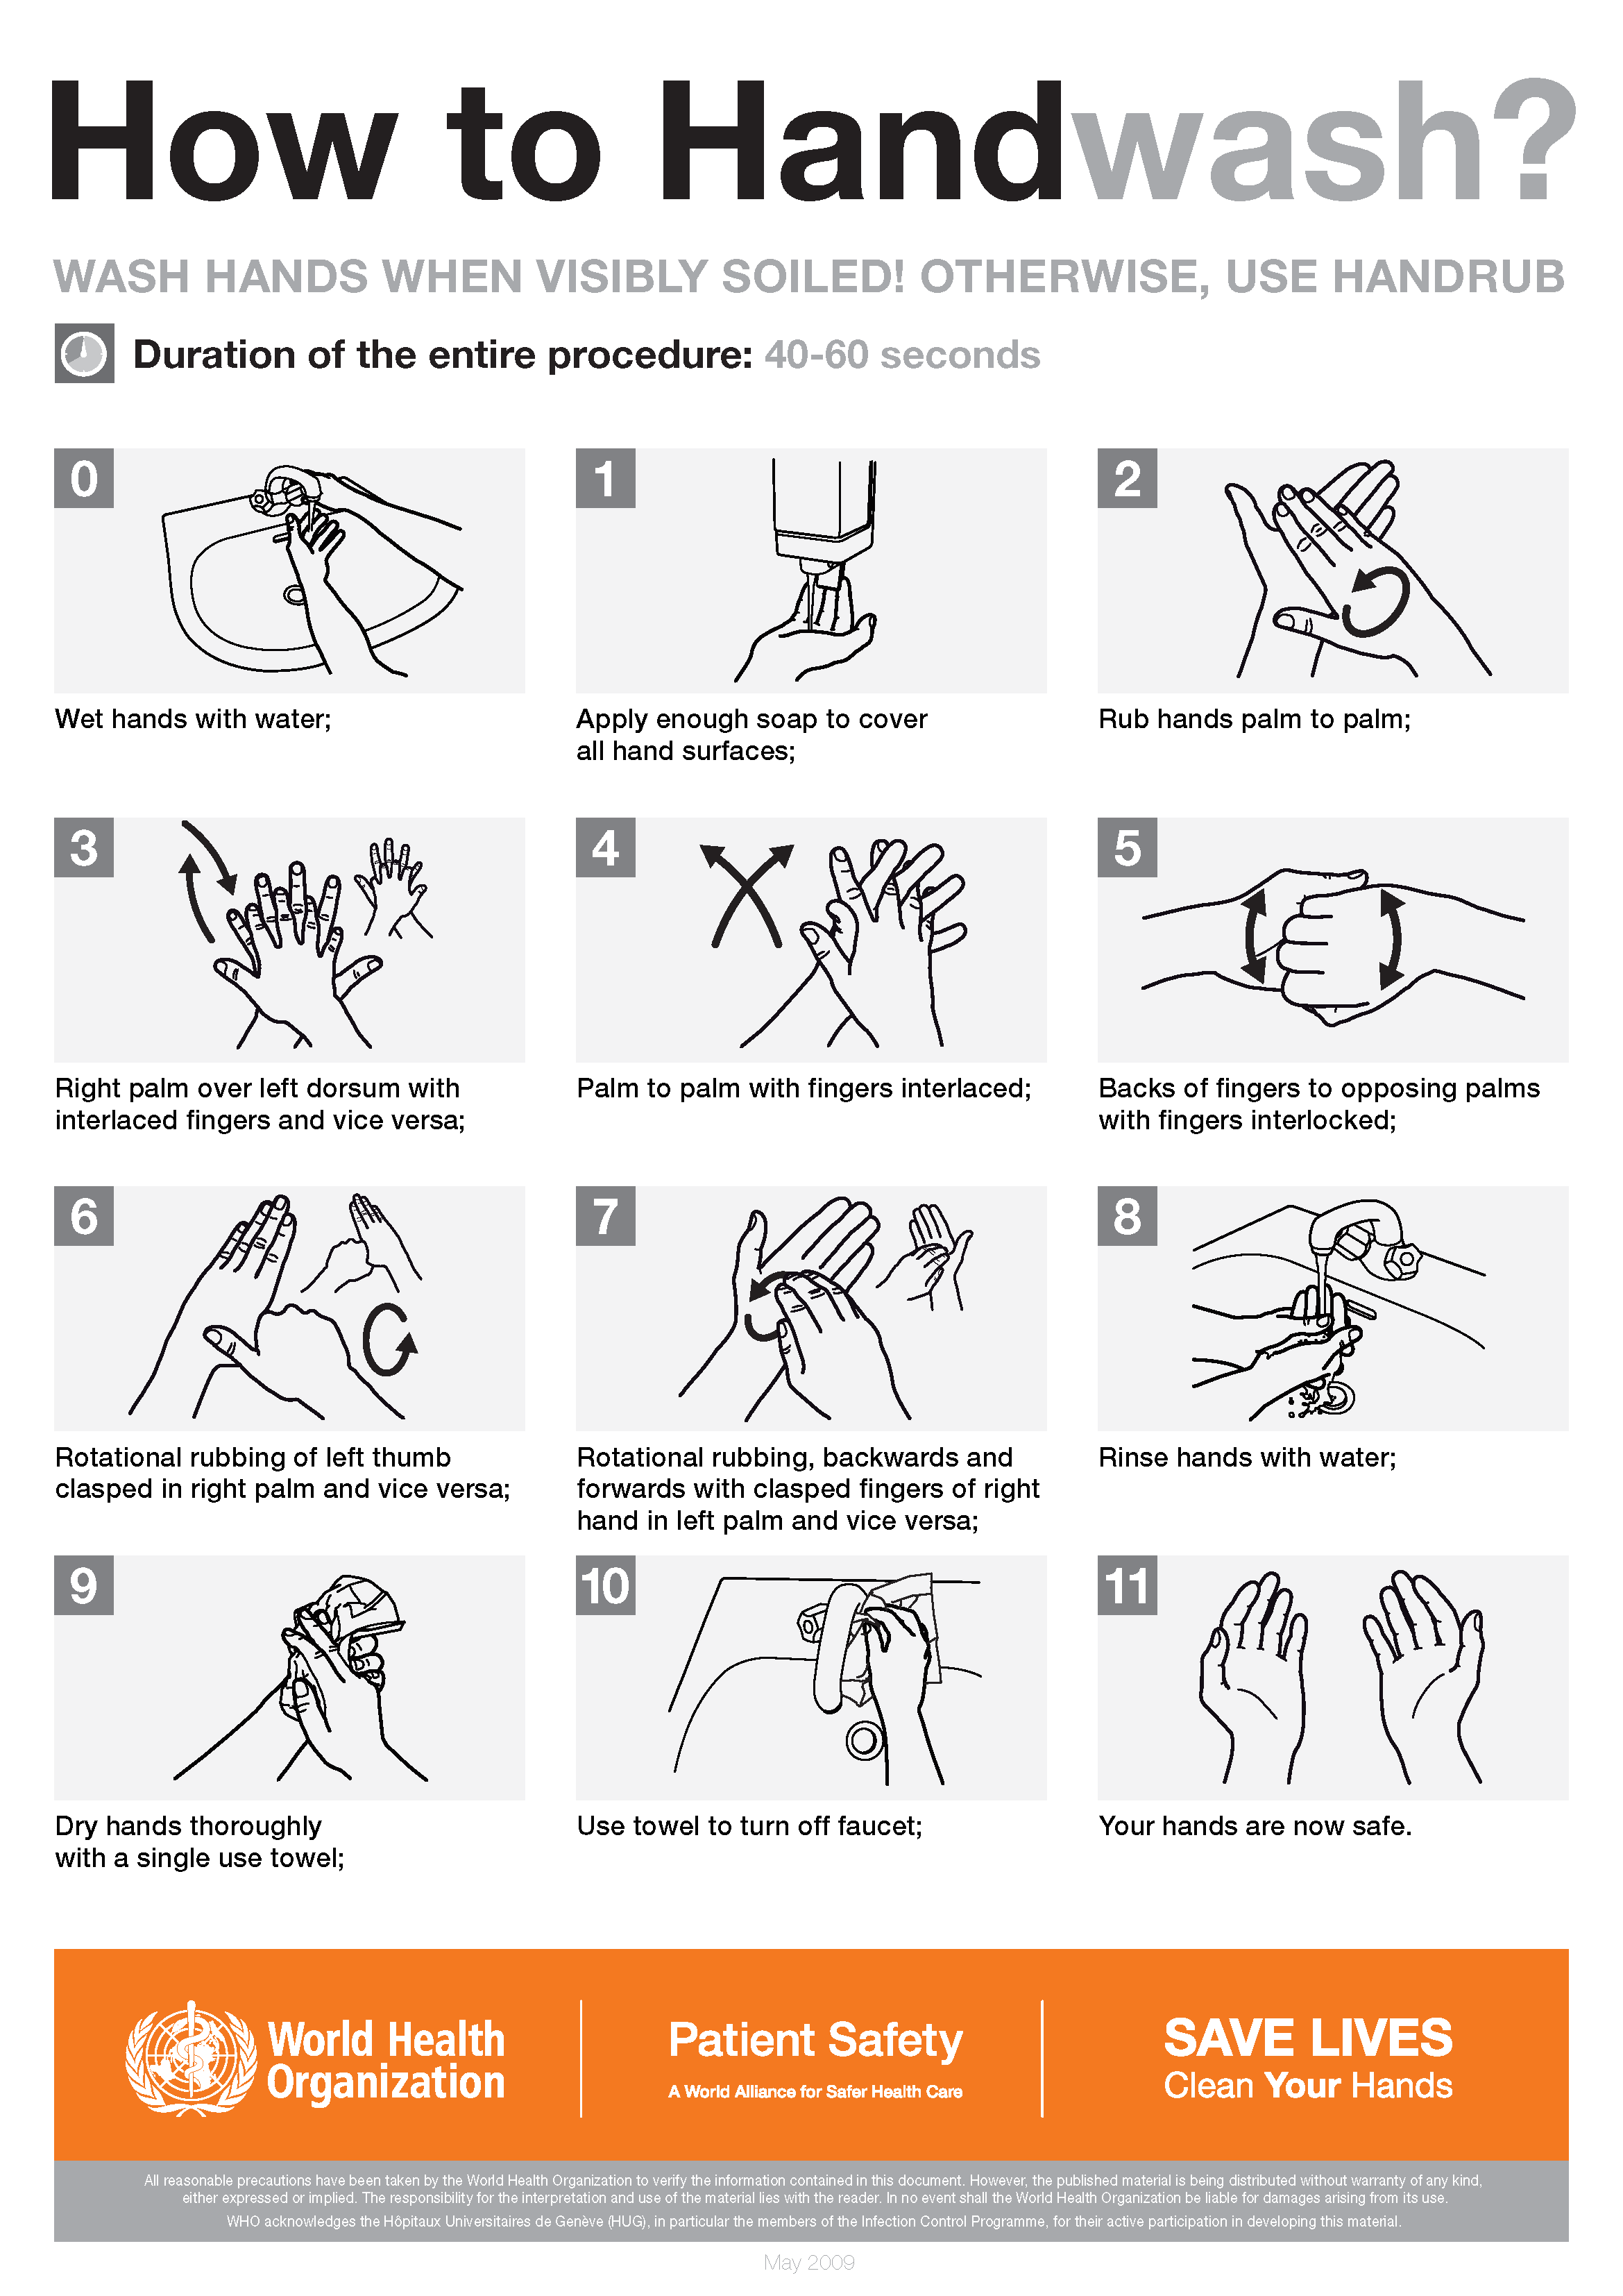
Review of Hand Washing with Soap & Water
Hand Hygiene Techniques
Wet hands with water.
Apply soap to palm of hand.
Rub hands together, covering all surfaces for at least 15-20 seconds.
Rinse hands with water.
Dry hands with paper towel and use towel to turn off faucet.
  Paper towel prevents hands from being re-contaminated by faucet handles.
Notes:
This slide is provided as a review of the techniques only. Instruct participants that they may not represent the step-by-step procedure your facility follows when performing hand washing.
Optional Handout Use: To aid in the review of these hand washing techniques, the World Health Organization’s (WHO) poster displayed on this slide is provided in Handout #3.

Slide 19
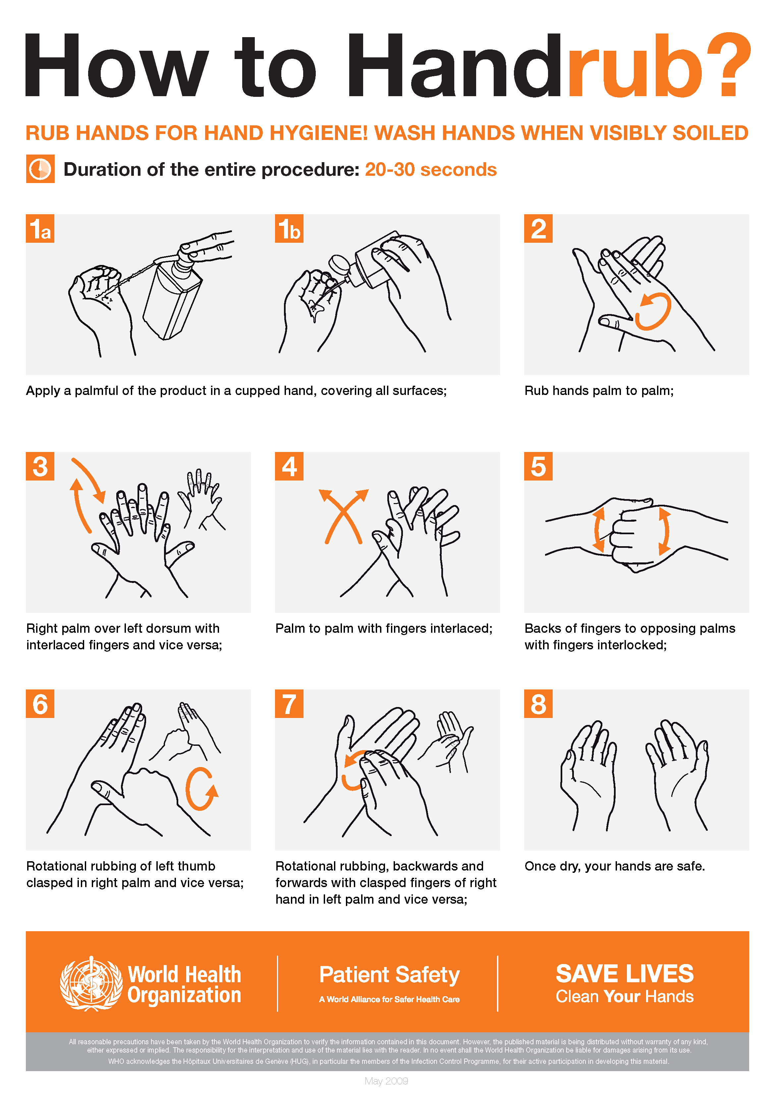
Review of Alcohol-Based Handrub
Hand Hygiene Techniques
Apply hand rub to palm of hand.
Rub hands together, covering all surfaces.
Focus on thumbs, tips of fingers, and under fingernails.
Hands are clean when dry.
  Usually takes about 15-20 seconds; follow manufacturer’s guidance.
Notes:
This slide is provided as a review of the techniques only. Instruct participants that they may not represent the step-by-step procedure your facility follows when using alcohol-based handrubs (ABHR) sanitizers.
Optional Handout Use: To aid in the review of these ABHR techniques, the World Health Organization’s (WHO) poster displayed on this slide is provided in Handout #4.

Slide 20
Question and Answer Session
Notes:
Encourage participants to ask questions to ensure they have a working understanding of how and when hand hygiene practices are to be implemented.
Using Handout #5, conduct a Hand Washing Competency Validation Checklist for each participant to determine if they can successfully demonstrate handwashing practices.
Using Handout #6, conduct a Competency Evaluation Exam for each participants to determine their knowledge and competency level concerning federal regulations and facility policies governing hand hygiene practices. (See below for Exam Answer Key)
Using the results of the Validation Checklist and the Competency Evaluation Exam, modify your Hand Hygiene training program as necessary to address any identified issues or concerns.
Instructor Note: Remind participants to sign the Record of Attendance Form. Be sure to complete all recordkeeping documentation. (See Part 3)
Exam Answer Key and Slide Location Where the Answer can be Found:
1=F (Slide #3); 2=T (Slide #5); 3=T (Slide #5); 4=T (Slide #6); 5=F (Slide #6); 6=T (Slide #6); 7=T (Slide #7); 8=T (Slide #8); 9=F (Slide #9); 10=F (Slides #10 & #11); 11=T (Slide #13); 12=T (Slide #14); 13=T (Slide #15); 14=F (Slide #17); 15=F (Step #12 of the Competency Validation Checklist. See Handout #5).

